Slide 1
Introduction
Title: Software Engineer Intern Task
Name: Doris Kawira Mwito
Date: 26/04/2025

Slide 2
Problem And Requirements
Requirements Addressed by the implemented solution:
Create health programs (TB/Malaria/HIV)
Register/manage clients
Program enrollment system
Client search functionality
Profile viewing with enrollments
Secure REST API endpoints

Slide 3
System Architecture
Tech Stack:
Backend: Django 4.2 + Django REST Framework
Database: PostgreSQL
Frontend: Bootstrap 5

Slide 4
Database Design
Code Snippet:
shows the database fields that needs to be populate as you interact with the system
class HealthProgram(models.Model):
name = models.CharField(max_length=100, unique=True) is_active = models.BooleanField(default=True)
class Client(models.Model):
first_name = models.CharField(max_length=100)
last_name = models.CharField(max_length=100)

Slide 5
API Implementation
Used django framework to implement the api endpoints and used postman to test the endpoints
endpoint request url:GET http://localhost:8000/api/clients/
Example response:[
{
"id": 1,
"first_name": "Doris",
"last_name": "Mwito",
"date_of_birth": "1990-12-03",
"created_by": 1
}
]

Slide 6
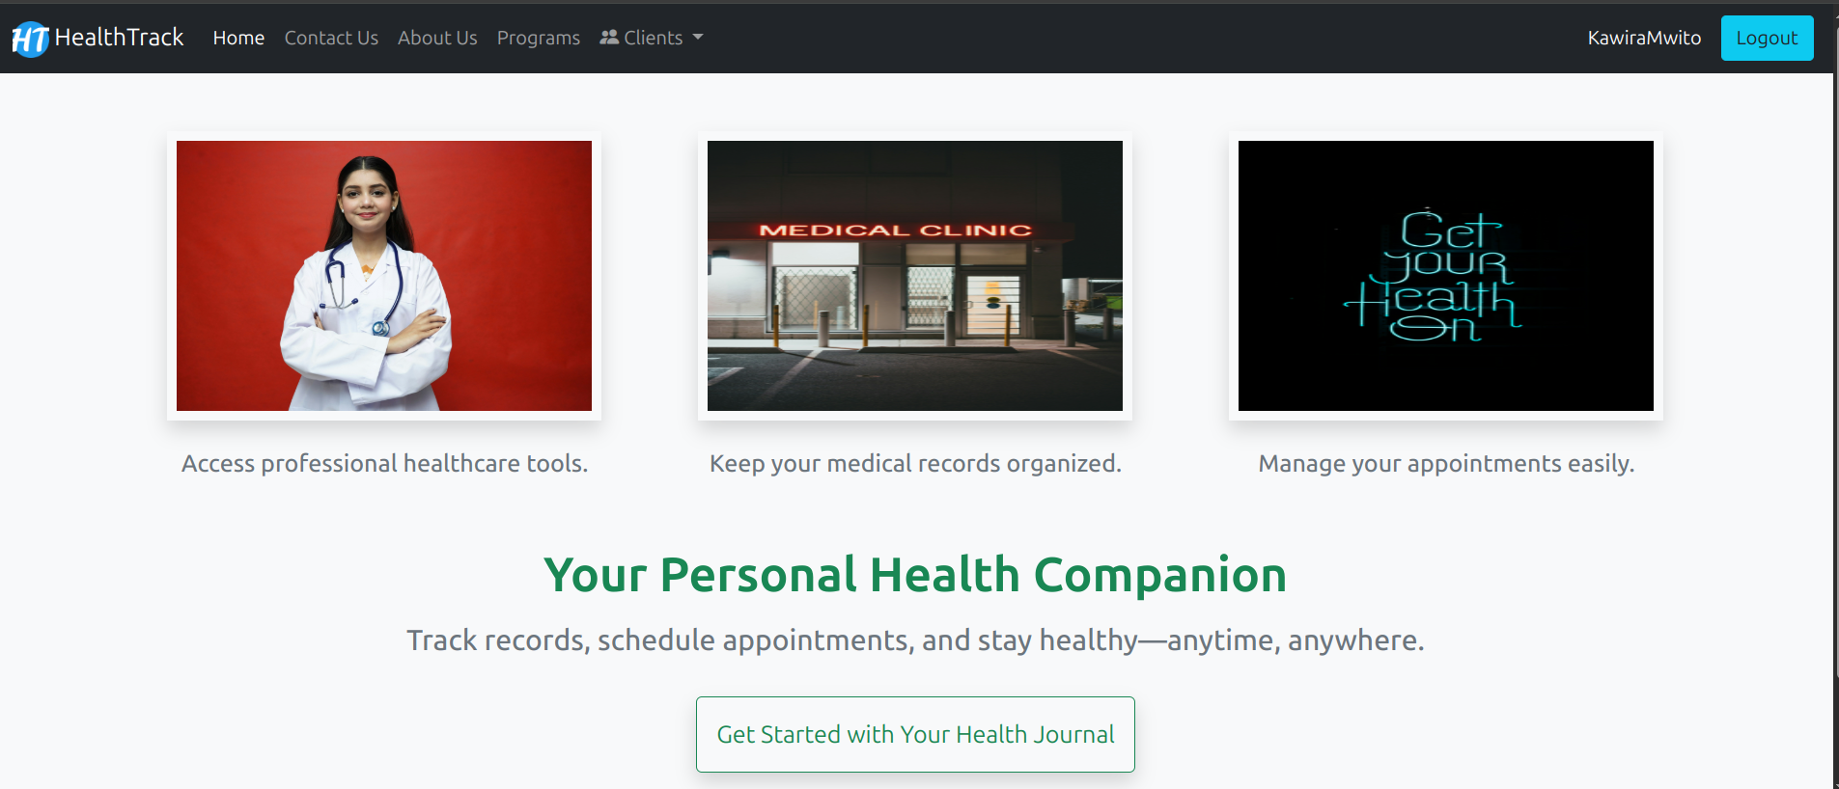
Home Page
Home Page with the features:contact,about, programs, clients

Slide 7
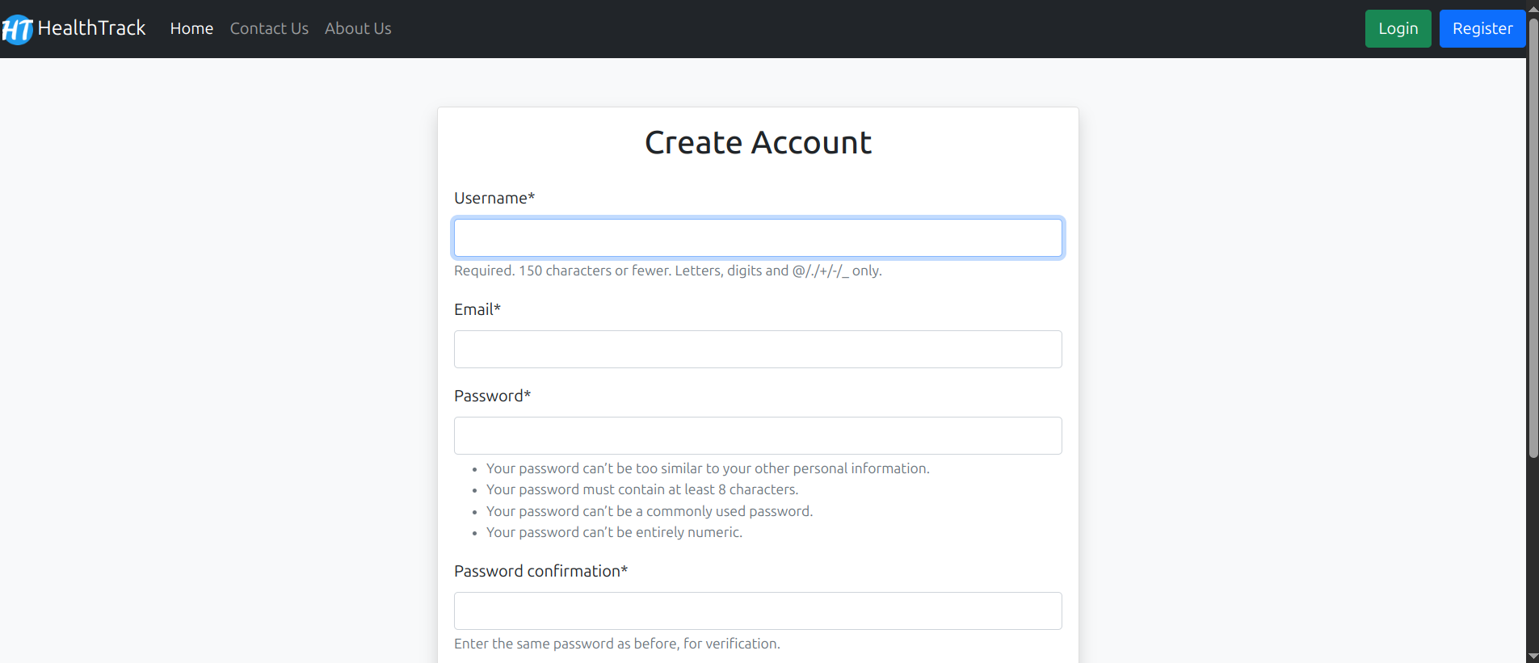
System User Registration Form

Slide 8
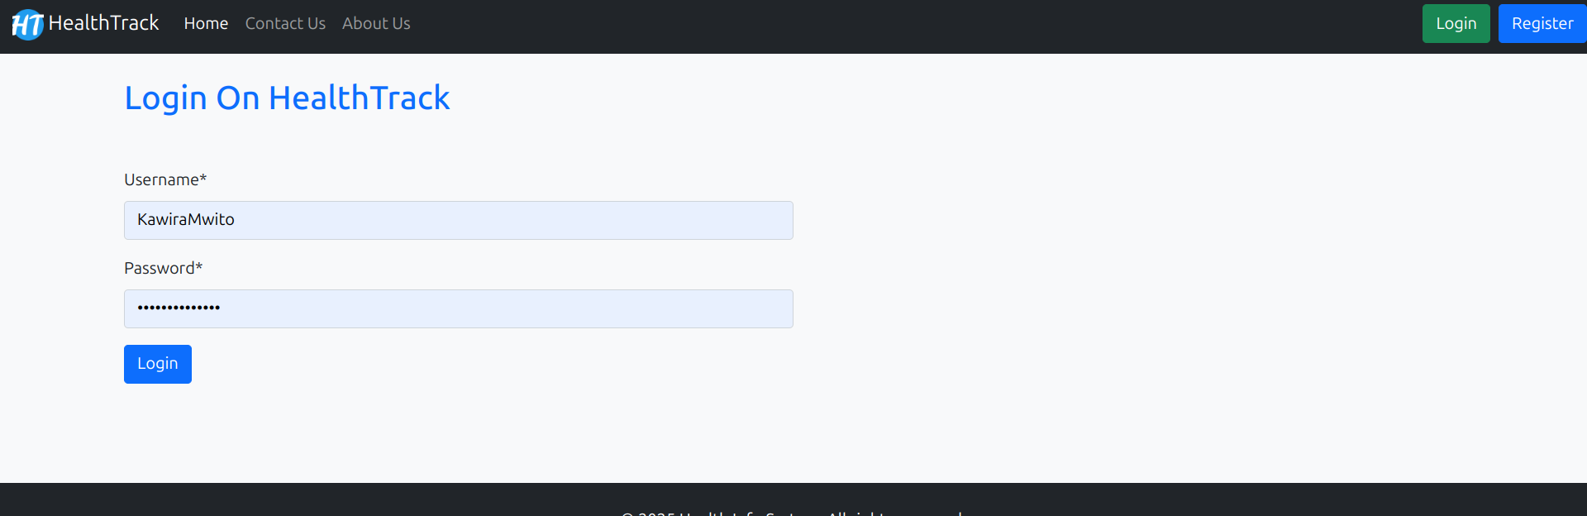
System User Login Form

Slide 9
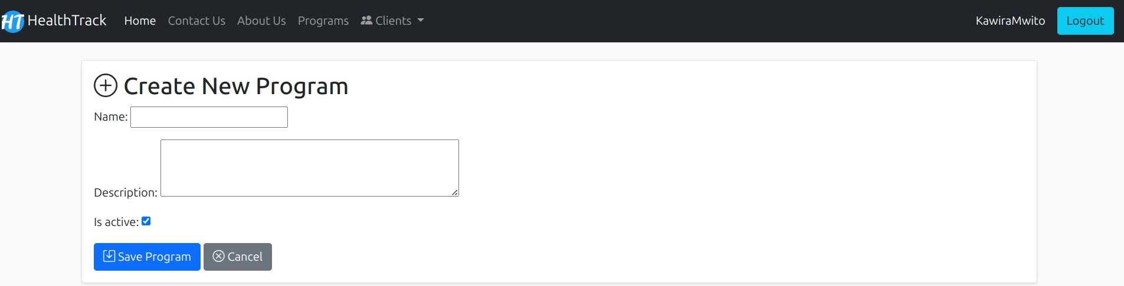
Create Program Form

Slide 10
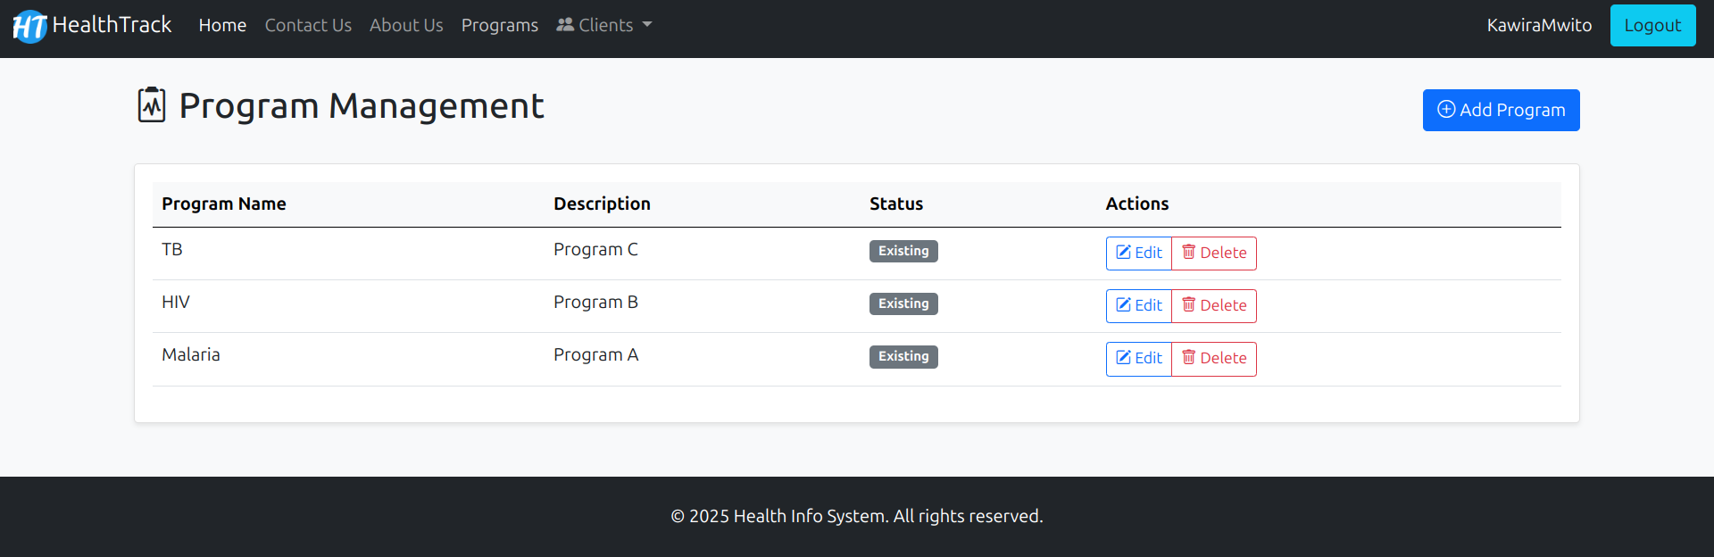
List Programs

Slide 11
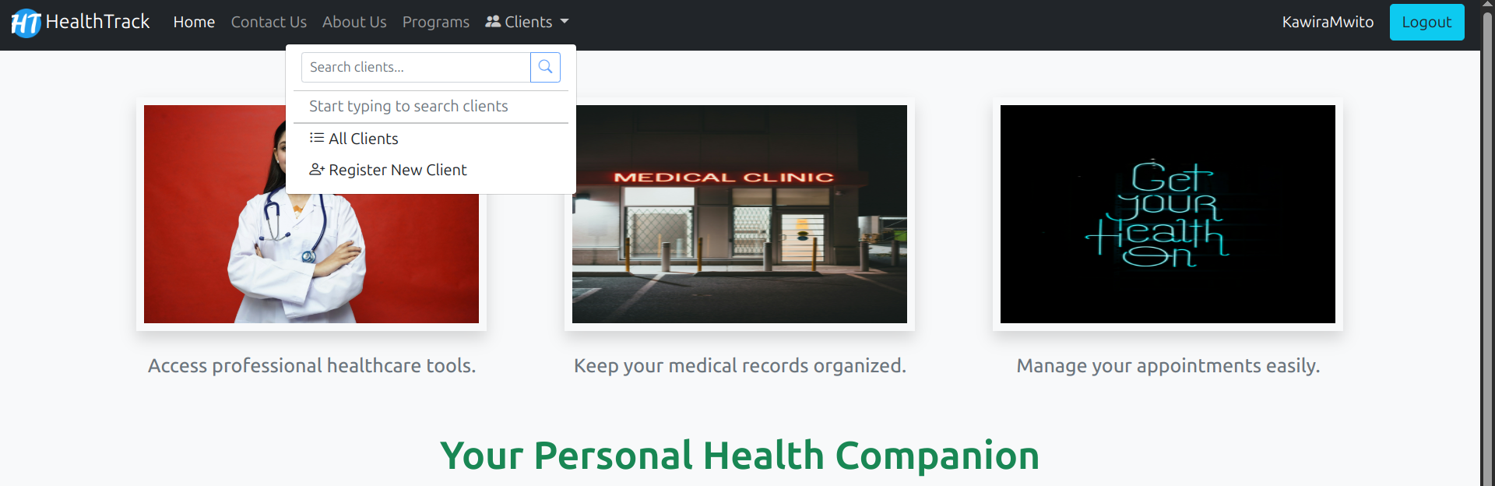
Client drop down Menu

Slide 12
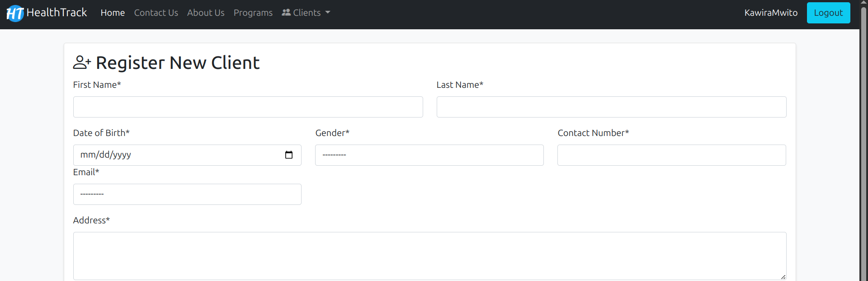
Register Client

Slide 13
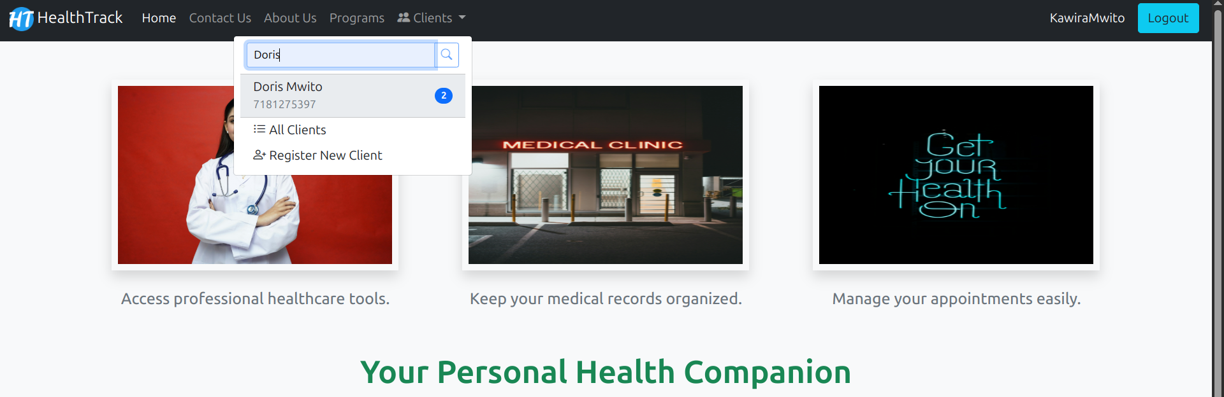
Search Client By Name

Slide 14
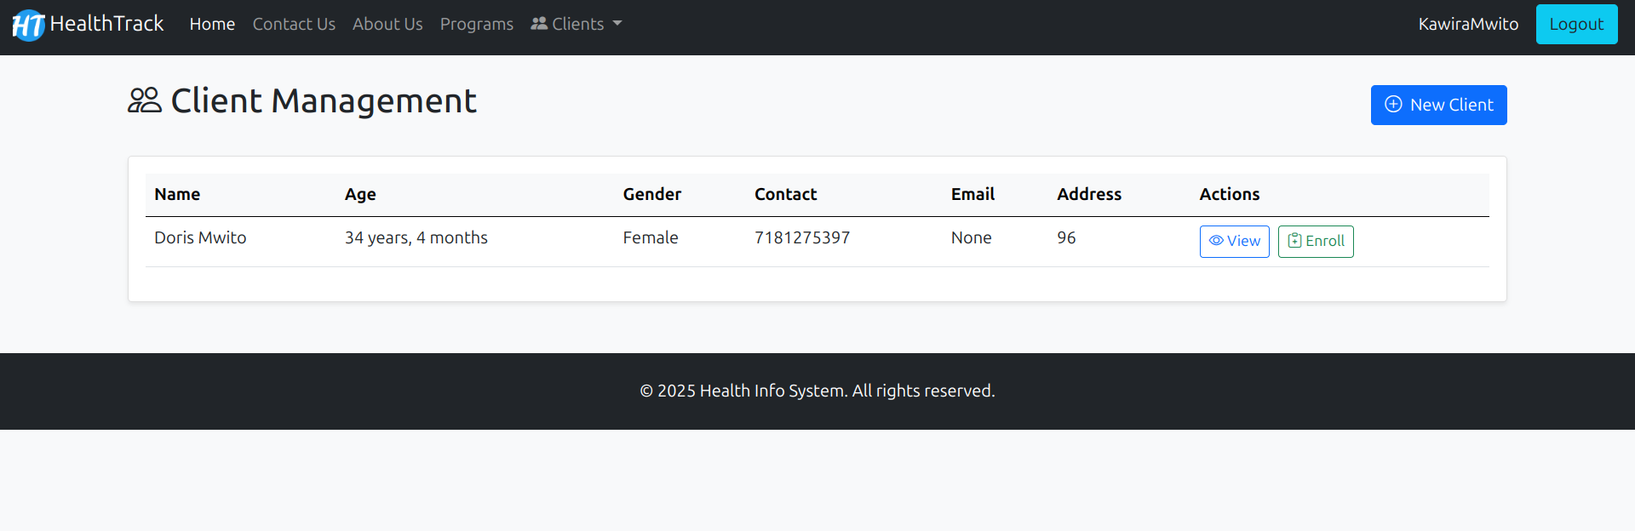
View Clients

Slide 15
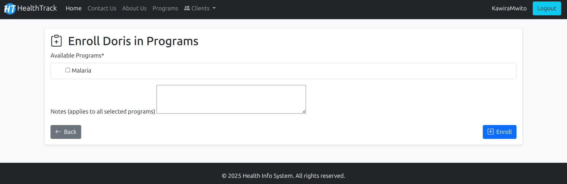
Enroll Clients To Programs

Slide 16
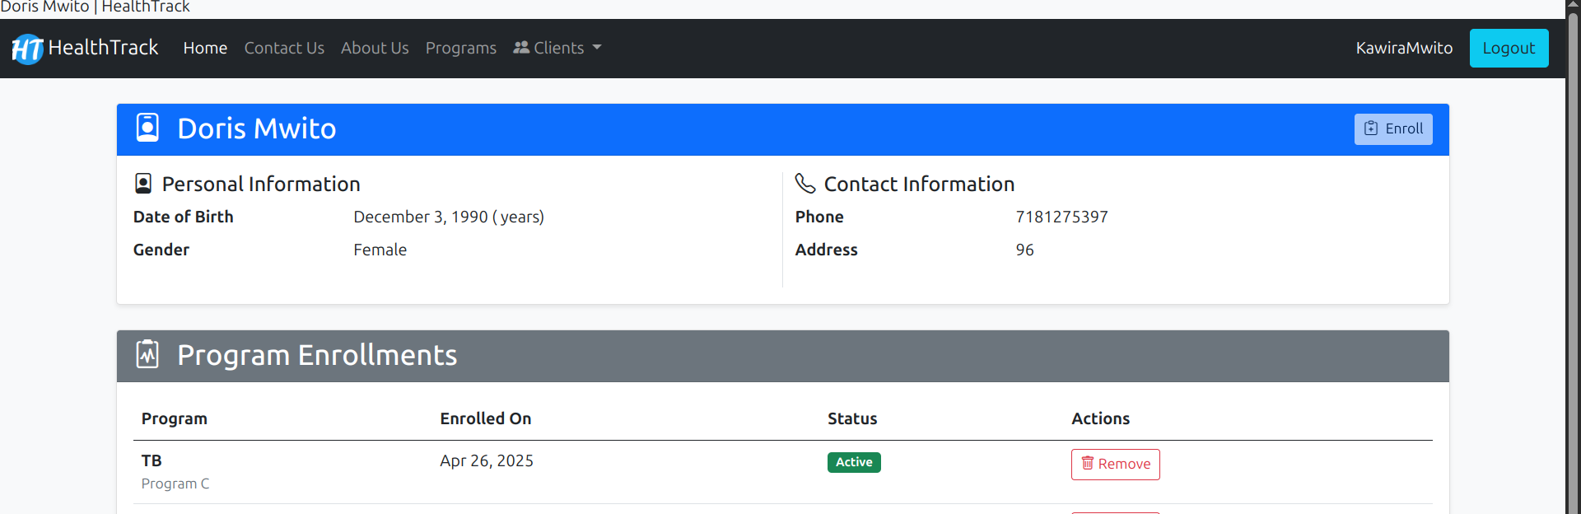
Client’s Profile

Slide 17
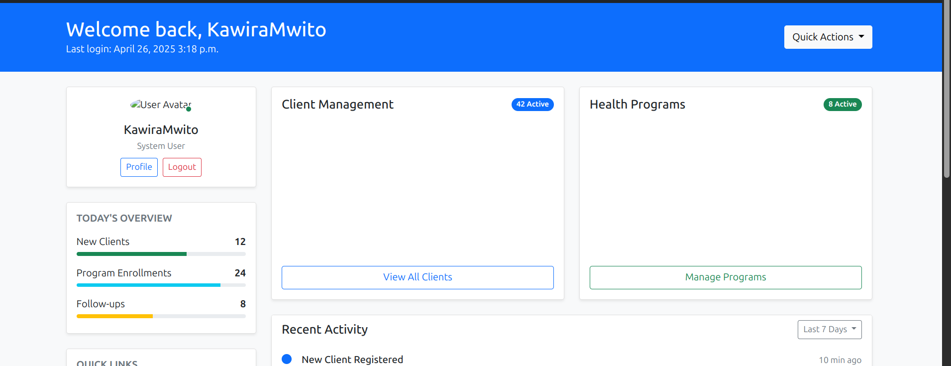
Dashboard Analytics

Slide 18
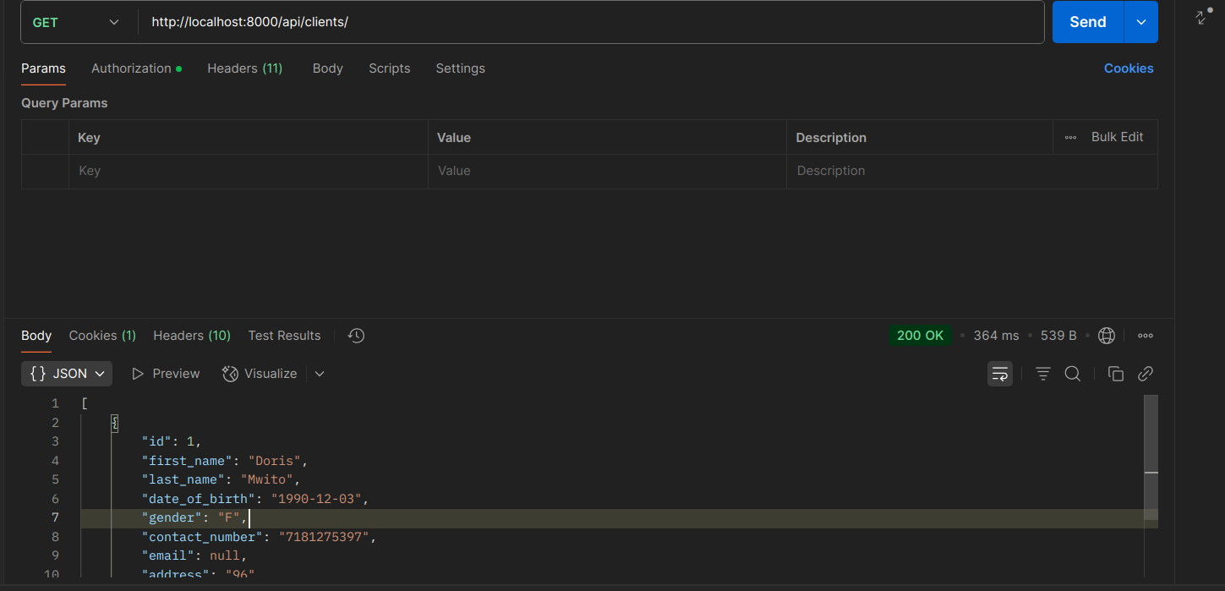
Postman Screenshot for the Clients Retrieval

Slide 19
Testing
Implemented unit tests for:
Models
Apis
Views
Urls

Slide 20
Security
Implemented:
CSFR for web forms
Tokens authorization for api

